Slide 1
GStore User Revenue Prediction
Blaine Murphy
October 2021

Slide 2
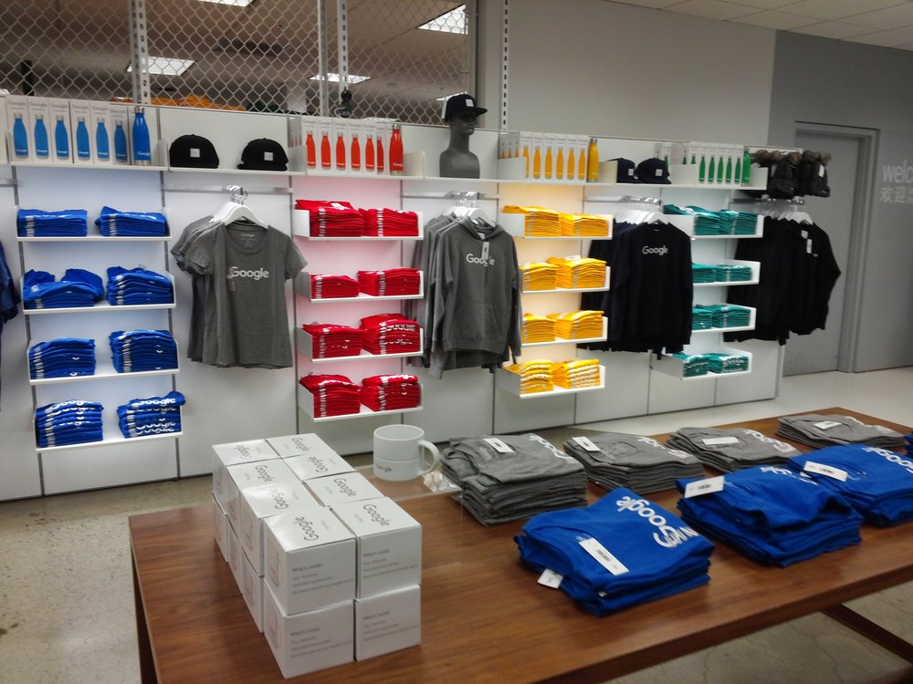
Outline
The Problem
Data
Analysis
Feature Engineering
Modelling
Observation & Interpretation
Recommendations
Future Work
Google Store (GStore) merchandise
Image from Kaggle competition

Slide 3
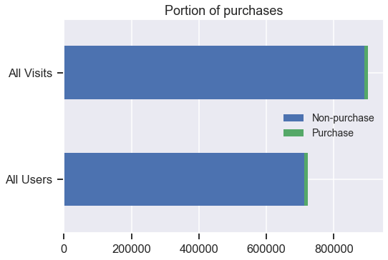
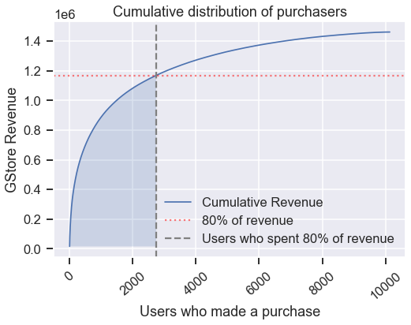
The Problem
The Google merchandise store has a familiar retail problem: the majority of their revenue comes from a small minority of store users/visitors
Only 1.2% visits result in a purchase
Only 1.4% of users made at least one purchase
A minority of purchasers are responsible for the majority of revenue
27% of users account for 80% of revenue
How to spend limited marketing dollars for the greatest impact to store revenue?
Goal: Analyze the data, build predictive model, and interpret features to understand key characteristics of users

Slide 4
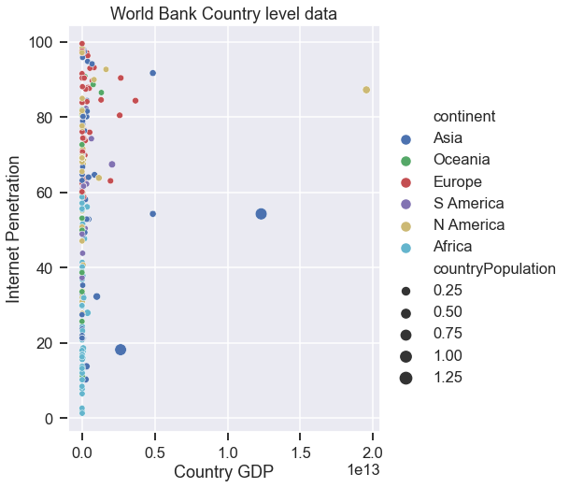
Data
The data available from GStore visits consists of 903,653 records and 11 columns
4 of the columns are nested dictionaries, and when completely flattened there are 29 columns.
The data were collected from August 1st, 2016 to August 1st, 2017.
Supplement with country level data from the World Bank
Population
GDP
Life Expectancy
Percent of population that use the internet

Slide 5
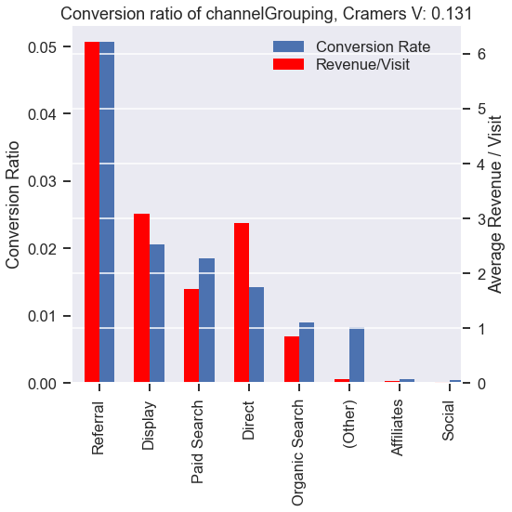
Analysis - categorical
Detailed analysis of all features, showing categorical ‘channelGrouping’ as example
χ² test done to check for correlation to whether there was a purchase or not
P-value of 0
Cramer’s V of 0.131
Low, but statistically significant correlation to purchase
Scored a Cramer’s V correlation to ‘medium’ of 1. ‘channelGrouping’ had higher correlation to a purchase, so ‘medium is dropped.
Will be one-hot encoded for modelling

Slide 6
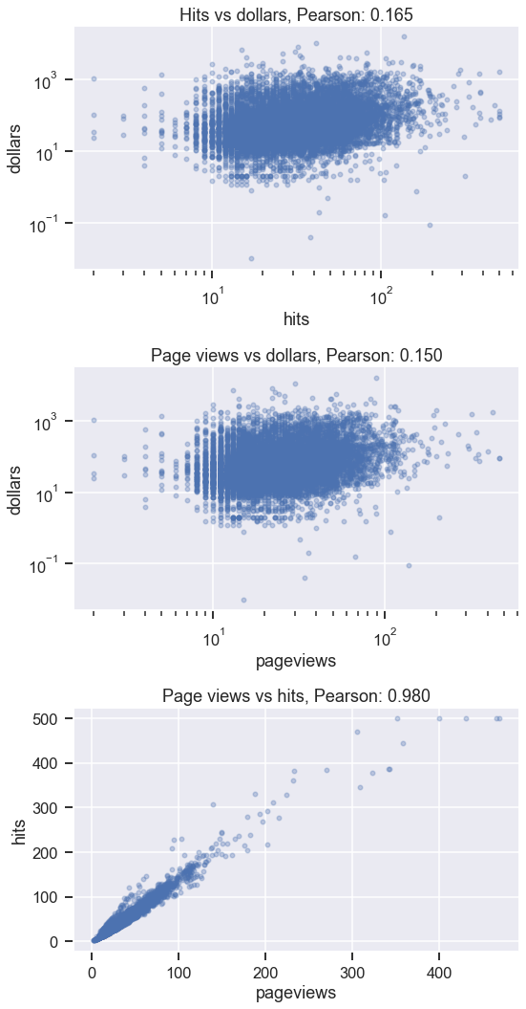
Analysis - numeric
Only numeric columns in GStore data are pageviews and hits
Both have a significant low positive Pearson correlation with the transaction
Hits: 0.165
Page views: 0.15
These two columns are highly correlated to each other, with a Pearson correlation of 0.98
These will likely be important predictors, but both probably aren’t necessary.

Slide 7
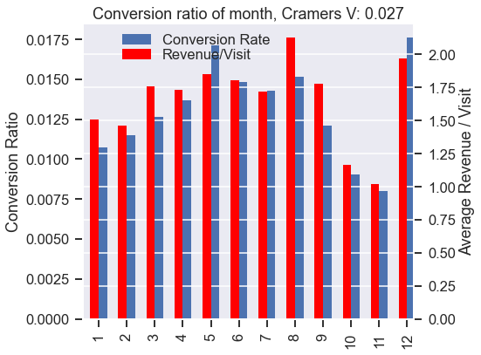
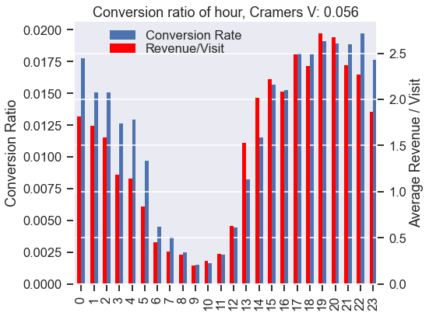
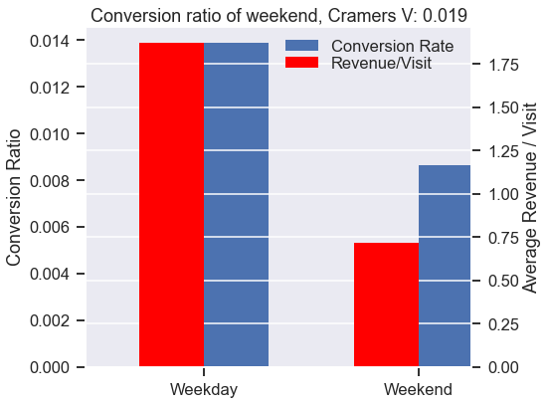
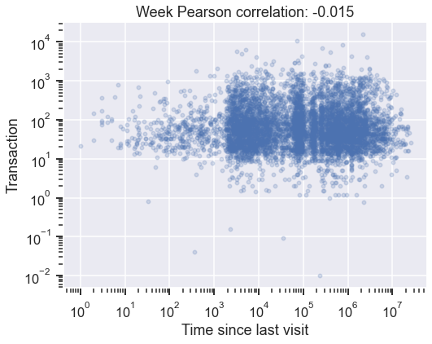
Analysis - time
The time of each visit is recorded in the data, extracted
Month of the year
Day of the week
Hour of the day
χ² test shows month, weekend, and hour of the day all have statistical significance to purchase but very weak association
Calculated time since last visit for repeated visits
Less than 1% of visits
Very weakly negatively correlated with purchase

Slide 8
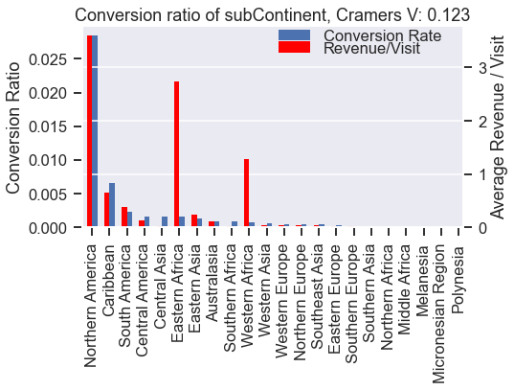
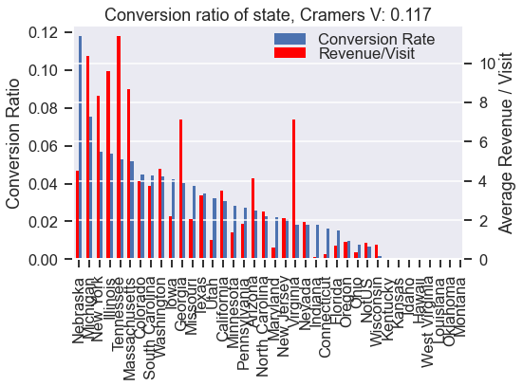
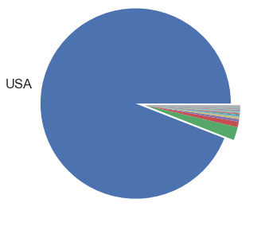
Analysis - geography
Data contains various levels of geographical info
Continent, sub-continent, country, region, metro, city
Sub-continent is a significant feature with moderate correlation to purchase but dominated by North America
Could lump low conversion categories
Large majority of revenue comes from the USA
Region is a 56% null, but does include states for US visitors
State has significant correlation to purchase
649 unique cities, most with 0 purchases.
Lumped into one category and reduced number to 134
Sub-continent, US state, cities one-hot encoded for modelling
Total Revenue by country

Slide 9
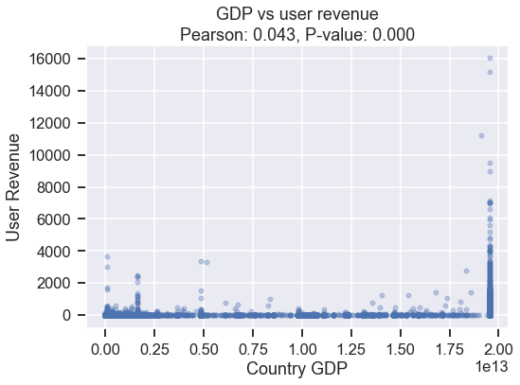
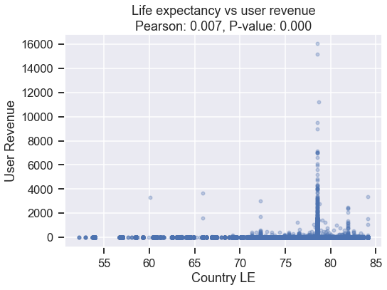
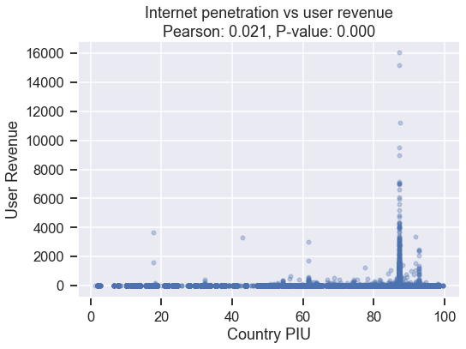
Analysis - World Bank data
Joined country level data from the World Bank
Population, GDP, Life expectancy, internet penetration
Small number of missing values replaced with medians from sub-continent
On a user level there is very weak but significant Pearson correlation to revenue

Slide 10
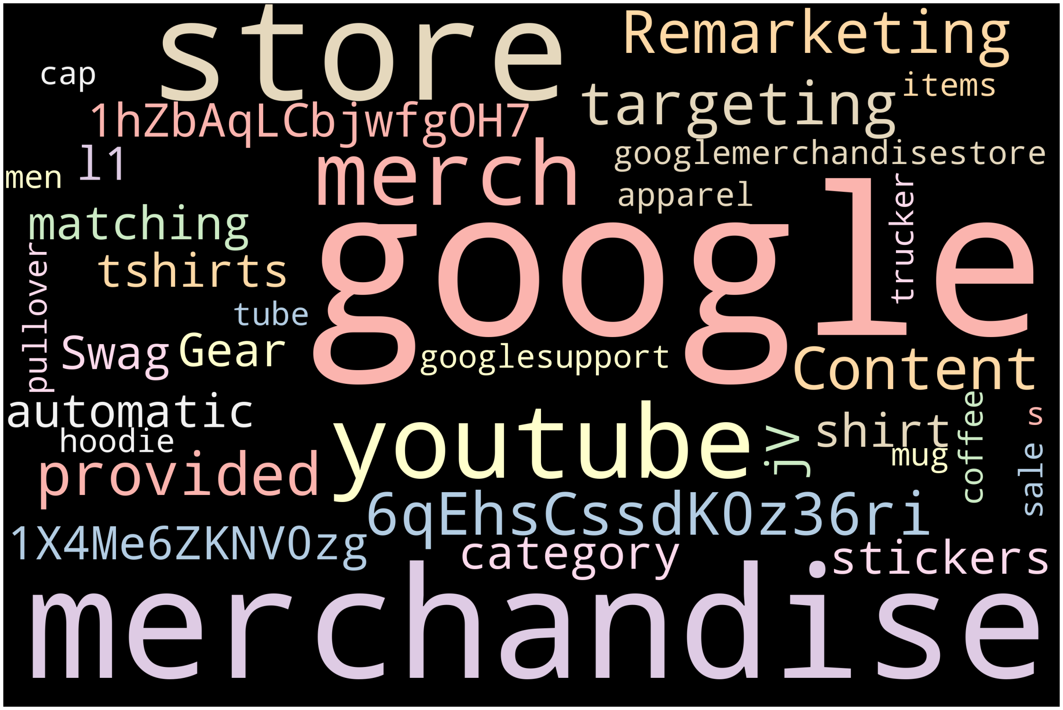
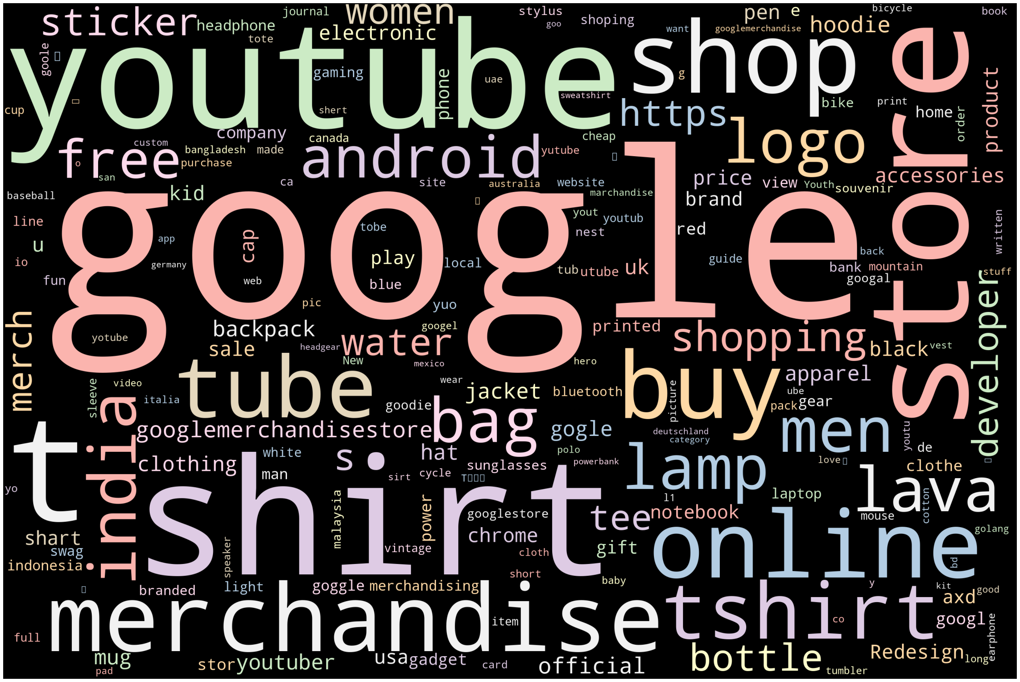
Analysis - keyword
55% of the ‘keyword’ column is null
Of keyword searches 99% occurred on Google
Tokens extracted from searches and plotted in word clouds
Created 7 binary columns representing most common search tokens from visits that resulted in a purchase
Unfortunately keyword searches that did not result in a purchase are similar
Keyword searches that resulted in purchases
Keyword searches that did NOT result in purchases

Slide 11
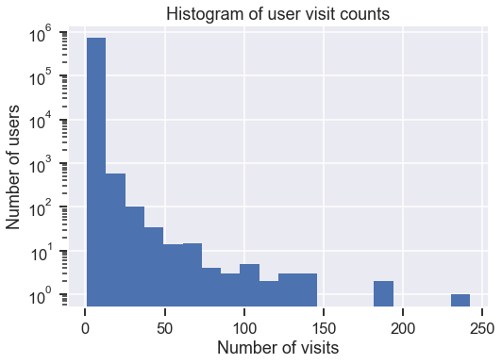
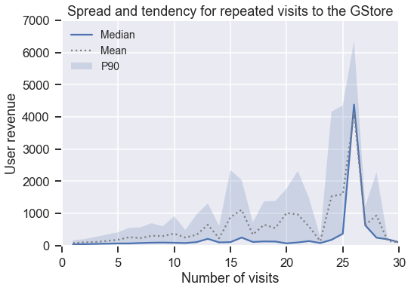
Analysis - visits
631,804 of the 722,668 unique users in the data only visited the store once.
Of those users who returned to the store at least once, the average number of visits is 2.97
The average user revenue tends to increase until a user exceeds 15 visits to the site.
Beyond 15 or so visits user revenue is weakly correlated with visit count.

Slide 12
Feature Engineering
Visit level data aggregated to user level
Created target revenue column ln(sum(user revenue)+1)
Created summary statistics for numeric columns (mean, median, max, min, std)
Mean for binary columns to capture any changes (e.g. isMobile or bounces)
Resulted in 358 features for 722,668 unique users
Removed 68 predictors due to multi-collinearity (for interpretability of final model)
Split data into 70-20-10, train-validation-test sets
Trained standard scaler on training predictors and applied to validation and test sets
Data ready for modelling

Slide 13
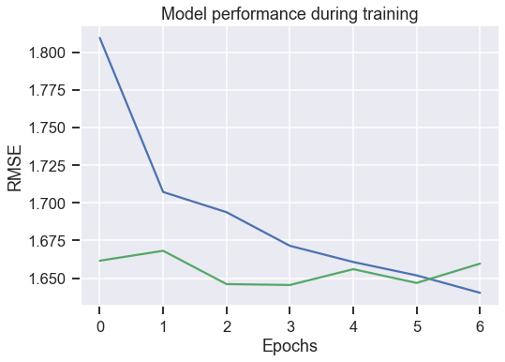
Modelling
Base case mean model RMSE: 2.08
Keras NN chosen for high accuracy and customizability
Model with 3 32-node dense layers with rectified linear (ReLU) activation functions
20% Dropout of first layer for regularization
Used ‘Adam’ optimizer and mean squared error loss function
Early stopping criteria applied during training to prevent overfitting
Data Set | RMSE
Training | 1.629
Validation | 1.639
Test | 1.658

Slide 14
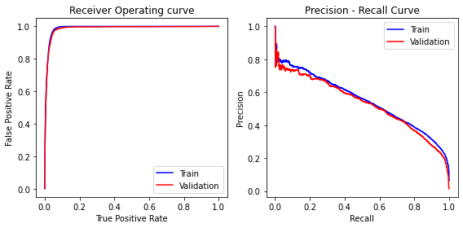
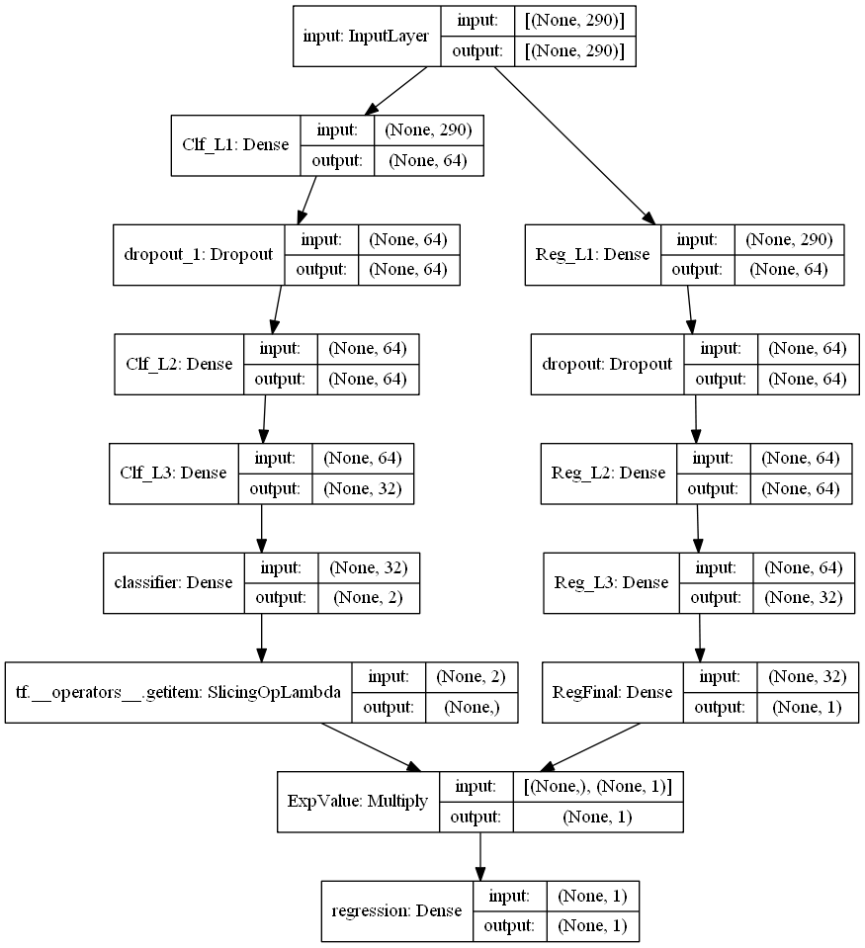
Modelling
NN Classifier for purchase
Additional attempts were made at improving model performance
Classifier for purchase then used as input into regression
Multi-output neural network that classifies purchases and performs regression
Segmentation models:
USA & International
Weekend & Weekday
Single-visit users & multi-visit users
Mobile & non-mobile
None provided improvement over base NN
Multi-output NN with classifier

Slide 15
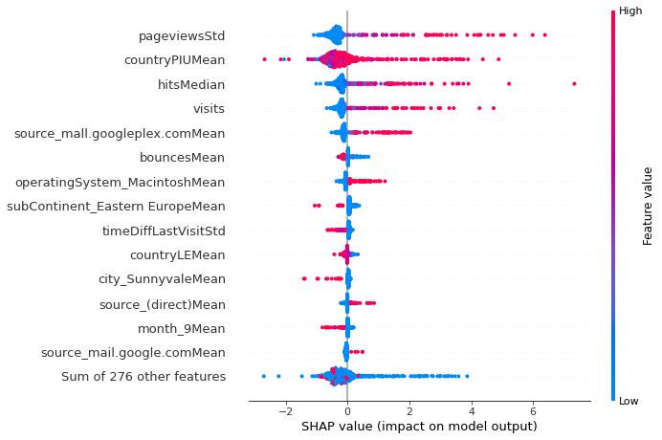
Observation & Interpretation
‘shap’ library utilized to calculate feature importance through permutation
Top 5 features positively correlated:
Page views deviation
User country internet penetration
Hits median
Visit count
Source ‘mall.googleplex.com’ (internal?)
Negatively correlated features:
Bounces
Time from last visit deviation
Top 15 Important Features by average SHAP value
Features ranked by average SHAP value

Slide 16
Recommendations
The model is ready for deployment and details are attached
Page views deviation and median hits signal that users who spend more time clicking through the site are more likely to spend more money.
The site developers could look at improving the site for ease of use, navigation and ability to hold user attention.
Internet penetration is important so marketing efforts should focus on areas with high rates of internet usage.
The number of user visits to the GStore does correlate to how much is spent.
Google can send notifications or marketing emails to users to encourage them to return to the site

Slide 17
Further Work
This project should be revisited periodically to utilize newly acquired visitor data, every 3 or 6 months
Look to improve prediction with integration of more detailed data
Details on the items that are purchased
Detailed user data pulled from other sources like the browser
Alternative ideas for modelling
Visit-level modelling
Treating repeated visits as time series
A/B testing for improvement of revenue or key correlated features
Site changes for increased page views and hits
Marketing materials to increase probability of return visits

